Slide 1


Apache Lucene
Vijay Kumar NM

Slide 2
Road Map
Problem Definition
A Basic Search Engine Pipeline
Meet Lucene
Lucene API Examples
Lucene Wrappers (Apache Solr, ElasticSearch, Regain, etc….)
Applied Lucene (Real Examples)

Slide 3
Problem Definition
You got a farm of data, and you want it to be searchable.
Analogy: Searching for a needle in a haystack with adding more hay to the stack!
SQL Databases Cons ( > 500,000,000 records …)
Scalability
Decentralization

Slide 4
What is Lucene?
Doug Cutting (Lucene 1999, Nutch 2003, Hadoop 2006)
Free, Java information retrieval library
Application related: Indexing, Searching
Sources can be SQL/NoSQL, Web Site, File System
High performance, A decade of research
Heavily supported, simply customized
No dependencies

Slide 5
What Lucene Ain’t
A complete search engine
An application
A crawler
A document filter/recognizer

Slide 6
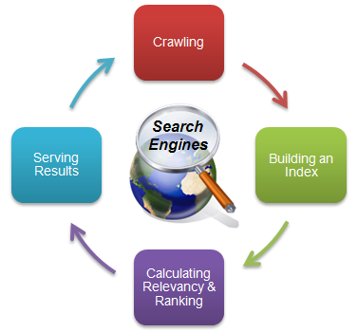
A Basic Search Engine Pipeline
Crawling: Grapping the data
Parsing [Optional]: Understanding the data
Indexing: Build the holding structure
Ranking: Sort the data
Searching: Read that holding structure
Behind The Scenes: Analysis, Tokenization, Query Parsing, Token Filtration, Index Inversion, etc…

Slide 7
Lucene Roles
Rich Document
Rich Document
Search UI
Gather Parse
Search App e.g. webapp
Make Doc
Index
Search
Index

Slide 8
Lucene Strength Points
Simple API
Speed
Concurrency
Smart indexing (Incremental)
Near Real Time Search
Heavily Used, Supported

Slide 9
Concepts

Slide 10
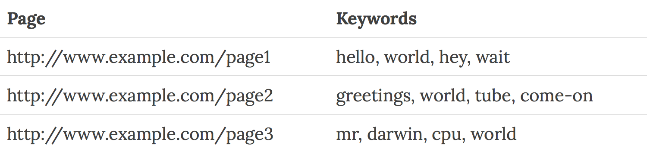
1. Searching and Indexing
Fast because, it searches an index instead of searching the text.
Uses Inverted index, equivalent of retrieving pages in a book related to a keyword by searching the index at the back of a book, as opposed to searching the words in each page of the book.
Forward Index

Slide 11
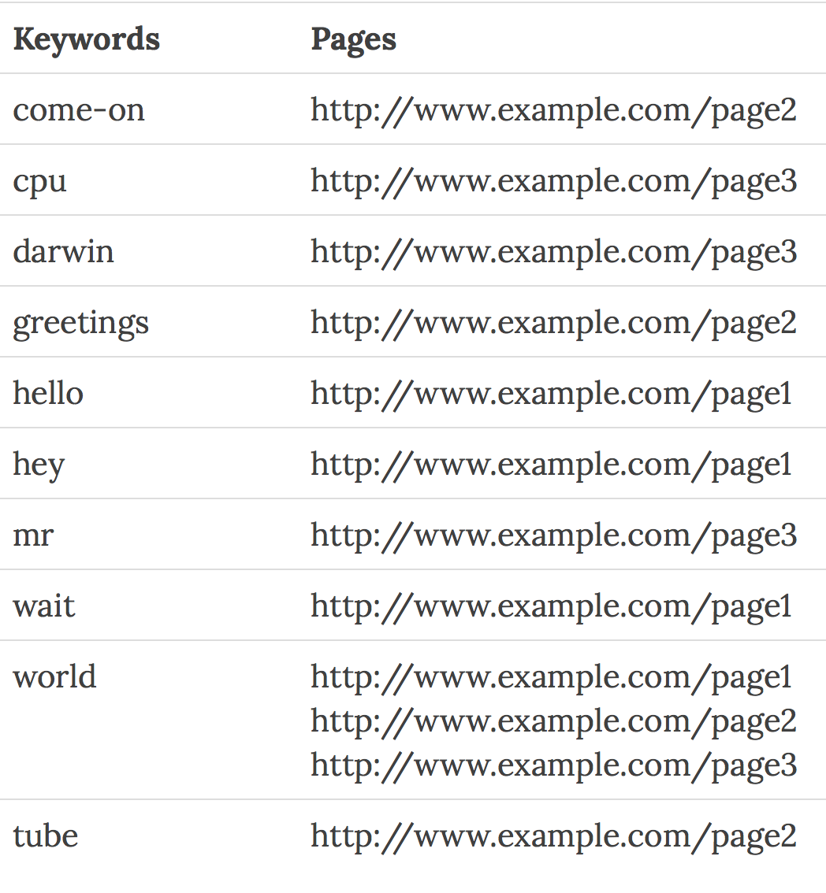
Inverted Index

Slide 12
2. Documents
Document is the unit of search and index in Lucene
An index consists of one or more Documents.
Indexing involves adding Documents to an IndexWriter
Searching involves retrieving Documents from an index via an IndexSearcher.
A Lucene Document doesn't necessarily have to be a document in the common English sense

Slide 13
3. Fields
A Document consists of one or more Fields.
A Field is simply a name-value pair. For example, title.
Indexing in Lucene thus involves creating Documents comprising of one or more Fields, and adding these Documents to an IndexWriter.

Slide 14
4. Searching and Queries
Search involves creating a Query (usually via a QueryParser) and handing this Query to an IndexSearcher, which returns a list of Hits.
Lucene has its own mini-language for performing searches, called Lucene query language
The Lucene query language allows the user to specify
which field(s) to search on,
which fields to give more weight to (boosting),
the ability to perform boolean queries (AND, OR, NOT)
and other functionality.

Slide 15
5. Segments
Lucene indexes may be composed of multiple sub-indexes, or segments. Each segment is a fully independent index, which could be searched separately. Indexes evolve by:
Creating new segments for newly added documents.
Merging existing segments.
Searches may involve multiple segments and/or multiple indexes, each index potentially composed of a set of segments.

Slide 16
6. Document Numbers
Internally, Lucene refers to documents by an integer document number.
The first document added to an index is numbered zero, and each subsequent document added gets a number one greater than the previous.
Note that a document's number may change, so caution should be taken when storing these numbers outside of Lucene.
Points to consider
The numbers stored in each segment are unique only within the segment
When documents are deleted, gaps are created in the numbering
Gaps are eventually removed as the index evolves through merging.
Deleted documents are dropped when segments are merged.
A freshly-merged segment thus has no gaps in its numbering.

Slide 17
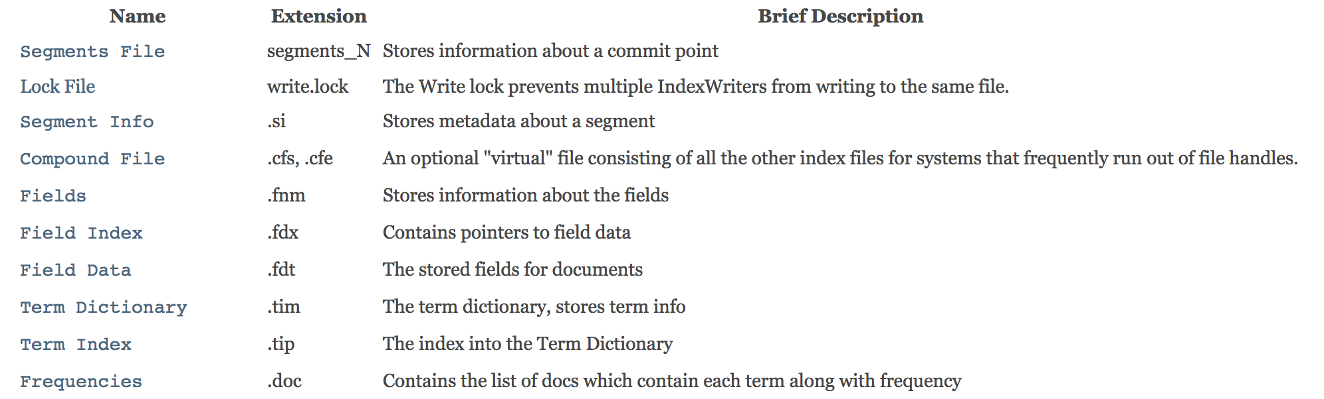
7. File Extensions

Slide 18
8. Scoring
Lucene scoring is the heart of why we all love Lucene. It is blazingly fast and it hides almost all of the complexity from the user
Lucene scoring supports a number of pluggable information retrieval models, including:
Vector Space Model (VSM)
Probabilistic Models such as Okapi BM25 and DFR
Language models
These models can be plugged in via the Similarity API, and offer extension hooks and parameters for tuning.

Slide 19
8. Scoring (Continued…)
Scoring is very much dependent on the way documents are indexed, so it is important to understand indexing
Be sure to use the IndexSearcher.explain(Query, doc) to understand how the score for a certain matching document was computed.

Slide 20
8. Scoring (Continued…)
The Query determines which documents match (a binary decision), while the Similarity determines how to assign scores to the matching documents.
In Lucene, the objects we are scoring are Documents.
A Document is a collection of Fields.
Each Field has semantics about how it is created and stored (tokenized, stored, etc).
Lucene scoring works on Fields and then combines the results to return Documents. This is important because two Documents with the exact same content, but one having the content in two Fields and the other in one Field may return different scores for the same query due to length normalization.

Slide 21
Score Boosting
The Query determines which documents match (a binary decision), while the Similarity determines how to assign scores to the matching documents.
In Lucene, the objects we are scoring are Documents.
A Document is a collection of Fields.
Each Field has semantics about how it is created and stored (tokenized, stored, etc).
Lucene scoring works on Fields and then combines the results to return Documents. This is important because two Documents with the exact same content, but one having the content in two Fields and the other in one Field may return different scores for the same query due to length normalization.

Slide 22
Score Boosting (Continued…)
Lucene allows influencing search results by "boosting" at different times:
Index-time boost by calling Field.setBoost() before a document is added to the index.
Query-time boost by applying a boost to a query by wrapping with BoostQuery.
Indexing time boosts are pre-processed for storage efficiency

Slide 23
Changing Scoring
Changing Similarity is an easy way to influence scoring, this is done at
Index-time
IndexWriterConfig.setSimilarity(Similarity)
Query-time
IndexSearcher.setSimilarity(Similarity)
Indexing time boosts are pre-processed for storage efficiency

Slide 24
Lucene Query Types
Single Term VS. Multi-Term “+name: camel + type: animal”
Wildcard Queries “text:wonder*”
Fuzzy Queries “room~0.8”
Range Queries “doj:[25/5/2000 To *]”
“title:{Apple To Banana}”
Grouped Queries “text: animal AND small”
Proximity Queries “apache Jakarta”~10
Boosted Queries “apache^5.0 AND Jakarta”

Slide 25
Lucene Indexing Pipeline
Tokenizer
TokenFilter
Document Writer
add
Document
Inverted Index

Slide 26
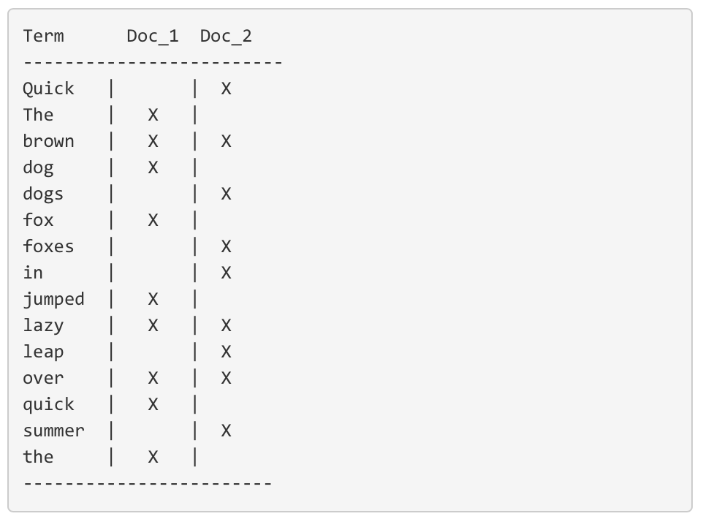
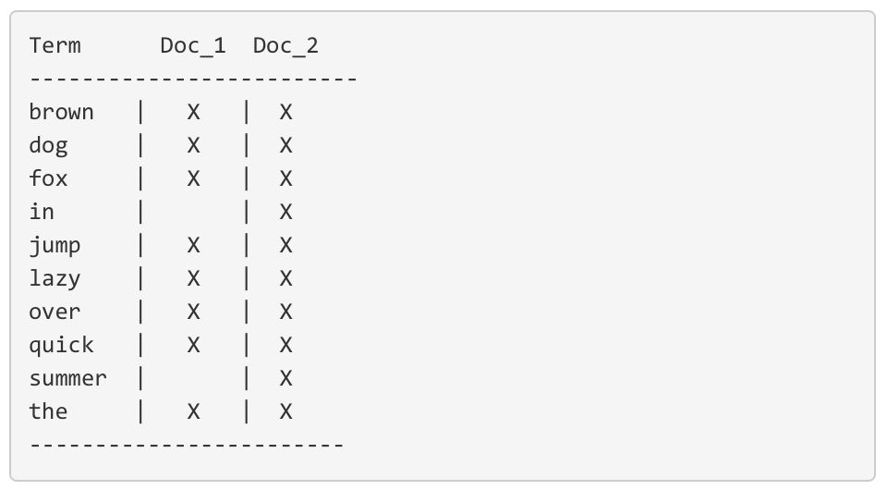
Stemming, Normalization and Lemmatization
Notes:
quick brown
But there are a few problems with our current inverted index:
Quick and quick appear as separate terms, while the user probably thinks of them as the same word.
fox and foxes are pretty similar, as are dog and dogs; They share the same root word.
jumped and leap, while not from the same root word, are similar in meaning. They are synonyms.

Slide 27
Analysis and Analyzer
This process of tokenization and normalization is called analysis, it consists of
First, tokenizing a block of text into individual terms suitable for use in an inverted index,
Then normalizing these terms into a standard form to improve their “searchability,” or recall
Analysis is performed by analyzers. An analyzer is really just a wrapper that combines three functions into a single package:
Character filters: The string is passed through any character filters to tidy up the string before tokenization. A character filter could be used to strip out HTML, XML or to convert & characters to the word and.
Tokenizer: Next the string is tokenized into individual terms by a tokenizer. A simple tokenizer might split the text into terms whenever it encounters whitespace or punctuation.
Token filters: Last, each term is passed through any token filters in turn, which can change terms (for example, lowercasing Quick), remove terms (for example, stopwords such as a, and, the) or add terms (for example, synonyms like jump and leap).

Slide 28
Analysis Basic Types
"The quick brown fox jumped over the lazy 5 dogs”
StandardAnalyzer (default)
[quick] [brown] [fox] [jumped] [over] [lazy] [5] [dogs]
SimpleAnalyzer :
[the] [quick] [brown] [fox] [jumped] [over] [the] [lazy] [dogs]
WhitespaceAnalyzer :
[The] [quick] [brown] [fox] [jumped] [over] [the] [lazy] [5] [dogs]
StopAnalyzer :
[quick] [brown] [fox] [jumped] [over] [lazy] [5] [dogs]
Notes:
Note that you can even make your custom analyzers, It depends on the application needs

Slide 29
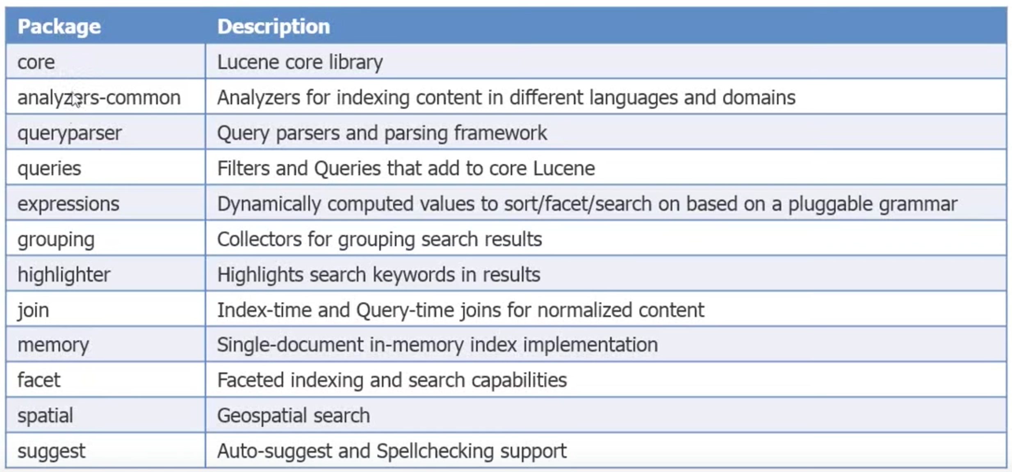
Key Packages

Slide 30
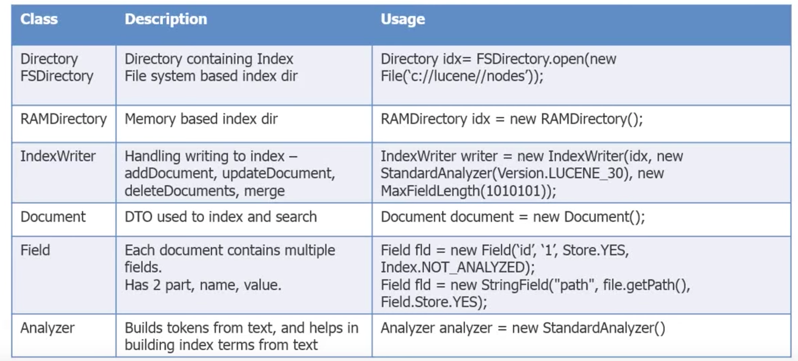
Write - API
Notes:
Note that you can even make your custom analyzers, It depends on the application needs

Slide 31
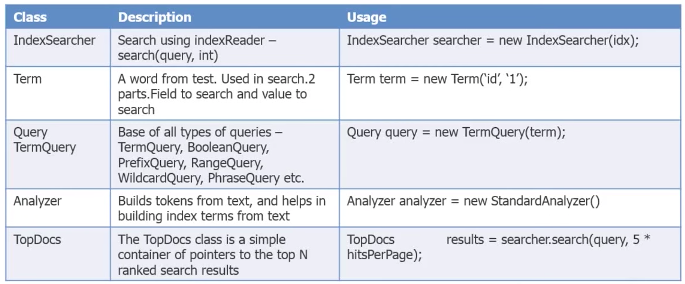
Read - API

Slide 32
IndexSearcher
Query
IndexSearcher
TopDocs
IndexReader
Directory

Slide 33
Core searching classes
TopDocs
Contains references to the top documents returned by a search
ScoreDoc
Represents a single search result

Slide 34
search() returns TopDocs
import org.apache.lucene.search.TopDocs;
...
public static void search(String indexDir, String q)
throws IOException, ParseException
...
IndexSearcher is = ...;
...
Query query = ...;
...
TopDocs hits = is.search(query, 10);
}

Slide 35
TopDocs contain ScoreDocs
import org.apache.lucene.search.ScoreDoc;
...
public static void search(String indexDir, String q)
throws IOException, ParseException
...
IndexSearcher is = ...;
...
TopDocs hits = ...;
...
for(ScoreDoc scoreDoc : hits.scoreDocs) {
Document doc = is.doc(scoreDoc.doc);
System.out.println(doc.get("fullpath"));
}
}

Slide 36
Closing IndexReader
public static void search(String indexDir, String q)
throws IOException, ParseException
...
IndexReader indexReader = ...;
...
indexReader.close();
}
Closes files associated with this index.
Also saves any new deletions to disk.
No other methods should be called after this has been called.

Slide 37
Closing IndexWriter
public static void indexDocs(String indexDir, Document q)
throws IOException, ParseException
...
IndexWriter indexWriter = ...;
...
indexWriter.close();
}
Closes all open resources and releases the write lock.
Note that this may be a costly operation, so, try to re-use a single writer instead of
closing and opening a new one

Slide 38
Fields
Fields may
Be indexed or not
Indexed fields may or may not be analyzed (i.e., tokenized with an Analyzer)
Non-analyzed fields view the entire value as a single token (useful for URLs, paths, dates, social security numbers, ...)
Be stored or not
In Lucene, fields may be stored, in which case their text is stored in the index literally, in a non-inverted manner.
Fields that are inverted are called indexed. A field may be both stored and indexed.
Useful for fields that you’d like to display to users
Optionally store term vectors
Like a positional index on the Field’s terms
Useful for highlighting, finding similar documents, categorization

Slide 39
Multi-valued fields
You can add multiple Fields with the same name
Lucene simply concatenates the different values for that named Field
Document doc = new Document();
doc.add(new TextField(“author”, “chris manning”));
doc.add(new TextField(“author”, “prabhakar raghavan”));
...

Slide 40
Tokenizers and TokenFilters
Tokenizer
WhitespaceTokenizer
KeywordTokenizer
LetterTokenizer
StandardTokenizer
...
TokenFilter
LowerCaseFilter
StopFilter
PorterStemFilter
ASCIIFoldingFilter
StandardFilter
...

Slide 41
Adding/deleting Documents to/from an IndexWriter
void addDocument(Iterable<IndexableField> d);
IndexWriter’s Analyzer is used to analyze document.
Important: Ensure that Analyzers used at indexing time are consistent with Analyzers used at searching time
// deletes docs containing terms or matching
// queries. The term version is useful for
// deleting one document.
void deleteDocuments(Term... terms);
void deleteDocuments(Query... queries);

Slide 42
Index format
Each Lucene index consists of one or more segments
A segment is a standalone index for a subset of documents
All segments are searched
A segment is created whenever IndexWriter flushes adds/deletes
Periodically, IndexWriter will merge a set of segments into a single segment
Policy specified by a MergePolicy
You can explicitly invoke forceMerge() to merge segments

Slide 43
Basic merge policy
Segments are grouped into levels
Segments within a group are roughly equal size (in log space)
Once a level has enough segments, they are merged into a segment at the next level up

Slide 44
Searching a changing index
Directory dir = FSDirectory.open(...);
DirectoryReader reader = DirectoryReader.open(dir);
IndexSearcher searcher = new IndexSearcher(reader);
Above reader does not reflect changes to the index unless you reopen it.
Reopening is more resource efficient than opening a brand new reader.
DirectoryReader newReader =
DirectoryReader.openIfChanged(reader);
If (newReader != null) {
reader.close();
reader = newReader;
searcher = new IndexSearcher(reader);
}

Slide 45
Near-real-time search
IndexWriter writer = ...;
DirectoryReader reader =
DirectoryReader.open(writer, true);
IndexSearcher searcher = new IndexSearcher(reader);
// Now let us say there’s a change to the index using writer
writer.addDocument(newDoc);
DirectoryReader newReader =
DirectoryReader.openIfChanged(reader, writer, true);
if (newReader != null) {
reader.close();
reader = newReader;
searcher = new IndexSearcher(reader);
}

Slide 46
Construct Querys programmatically
TermQuery
Constructed from a Term
TermRangeQuery
NumericRangeQuery
PrefixQuery
BooleanQuery
PhraseQuery
WildcardQuery
FuzzyQuery
MatchAllDocsQuery

Slide 47
IndexSearcher
Methods
TopDocs search(Query q, int n);
Document doc(int docID);

Slide 48
TopDocs and ScoreDoc
TopDocs methods
Number of documents that matched the search totalHits
Array of ScoreDoc instances containing results scoreDocs
Returns best score of all matches getMaxScore()
ScoreDoc methods
Document id doc
Document score score

Slide 49
Scoring
Original scoring function uses basic tf-idf scoring with
Programmable boost values for certain fields in documents
Length normalization
Boosts for documents containing more of the query terms
IndexSearcher provides an explain() method that explains the scoring of a document

Slide 50
Crawling resources
Webpages: Jsoup
https://jsoup.org/
Or anything else similar, just not a full crawler
Twiter:
Twitter streaming API
https://dev.twitter.com/streaming/overview
Twitter4j
http://twitter4j.org/en/index.html

Slide 51
Crawling webpages
getNext
Download contents of page
1
Frontier
www.cs.ucr.edu
www.cs.ucr.edu/~vagelis
Parse the downloaded file
to extract links the page
2
getNext()
addAll(List)
Clean and Normalize the extracted links
Add(List<URLs>)
3
Store extracted links in the
Frontier
4

Slide 52
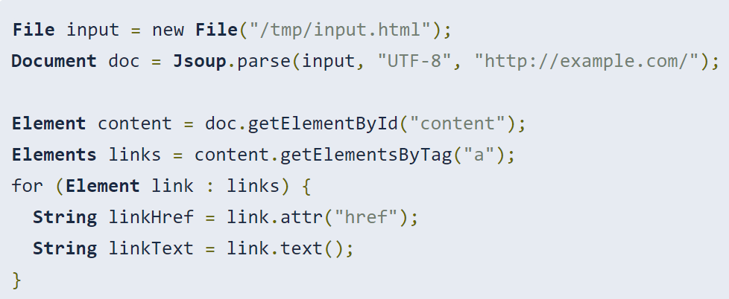
Crawling webpages - Jsoup
https://jsoup.org/
parse HTML from a URL, file, or string
find and extract data, using DOM traversal or CSS selectors
Don’t need to worry about details of parsing HTML files:
unclosed tags (e.g. <p>Lorem <p>Ipsum parses to <p>Lorem</p> <p>Ipsum</p>)

Slide 53
Crawler Ethics
Some websites don’t want crawlers swarming all over them.
Why?
Increases load on the server
Private websites
Dynamic websites
…
How does the website tell you (crawler) if and what is off limits.
Two options
Site wide restrictions: robots.txt
Webpage specific restrictions: Meta tag

Slide 54
Crawler Ethics
How does the website tell you (crawler) if and what is off limits.
Two options
Site wide restrictions: robots.txt
Webpage specific restrictions: Meta tag

Slide 55
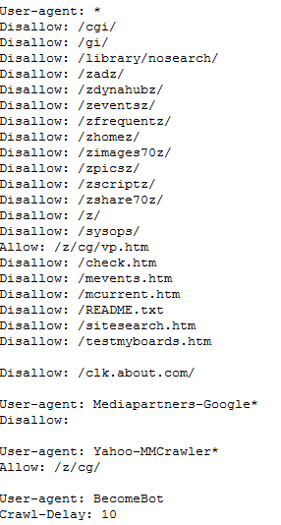
Crawler Ethics robots.txt
A file called “robots.txt” in the root directory of the website
Example: http://www.about.com/robots.txt
Format:
User-Agent: <Crawler name>
Disallow: <don’t follow path>
Allow: <can-follow-paths>

Slide 56
Crawler Ethics - Meta tags
Some webpages have one the following meta-tag entries:
<META NAME="ROBOTS" CONTENT="NOINDEX, FOLLOW">
<META NAME="ROBOTS" CONTENT="INDEX, NOFOLLOW">
<META NAME="ROBOTS" CONTENT="NOINDEX, NOFOLLOW">
Options:
INDEX or NOINDEX
FOLLOW or NOFOLLOW

Slide 57
Thank You

